Slide 1
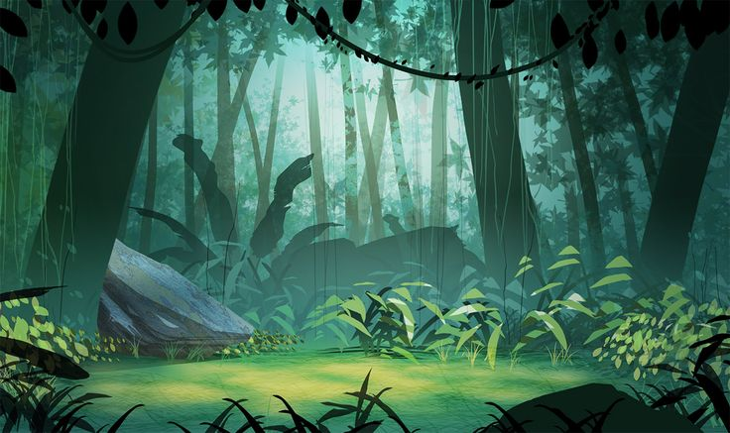
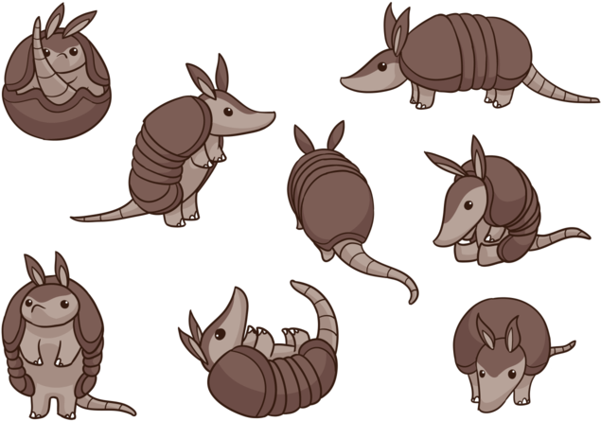

Alize Sevgi Yalçınkaya
Berkay Çağrı Soylu
Berke Sezgin
ENS 492 PRESENTATION

Slide 2
The Game: A Summary
The platform moves, an physics apply to relevant object with a non-kinetic rigidbody. The armadillo-ball moves around the platform collecting grapes and trying to get home to her cave. There are 10 levels, each in proportional size to the board and with various colours and modifications. The armadillo-ball gets stuck in her ball form and with enough sustenance, she is able to gather her strength and break free from her ball form. The timer and the collected grape count are the 2 parameters being kept and evaluated within the game that are presented in end-of-level screens and also kept in the reports along with the heatmap of coordinated the ball has traveled.

Slide 3
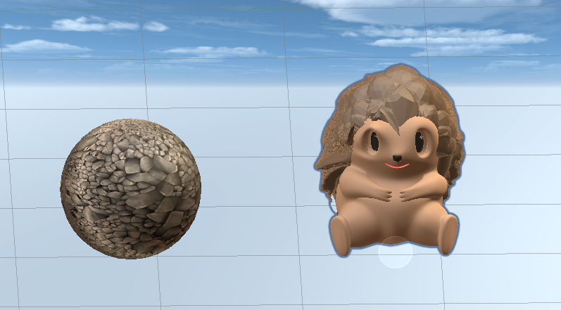
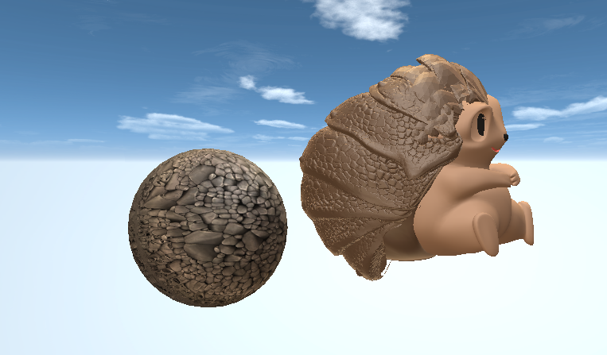
Armadillo in her ball and animal forms

Slide 4
How to Play
When you open up the game, first is the menu. If you’re a therapist, you can change hyperparameters to adjust difficulty. If you’re a player, you can log in and play.
The player moves on the Wii Balance Board which is what moves the platform. The platform holds an armadillo-ball, a labyrinth, grapes, decorations and a cave. The aim is to gather as many grapes as possible as you tilt the platform and move the armadillo-ball on its surface and moving through the labyrinth to get to the cave on the other side.
After each level you see how you did, and decide what to do. The report of how you did is stored in a database that is available to the therapist through the menu.
At the end of 10th level, you complete the game.

Slide 5
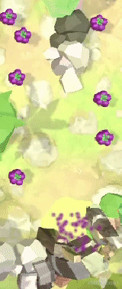
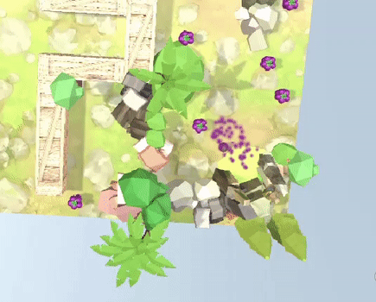
Grapes and The Cave
Reaching the cave

Slide 6
Hyperparameters: Zone
The therapist can optionally choose a certain zone to increase the amount of grapes in. This is to encourage the child to use that side more, to go to that area.
This is established by having 4 empty game objects in every scene. A player preference called Active Zone is passed through and according to that variable it is decided which game object will instantiate on average 4 grapes.
This variable can be changed in the menu by the therapist at any time. It can also be reset in the menu to have the default configurations in each level.
The effect is universal across levels.

Slide 7
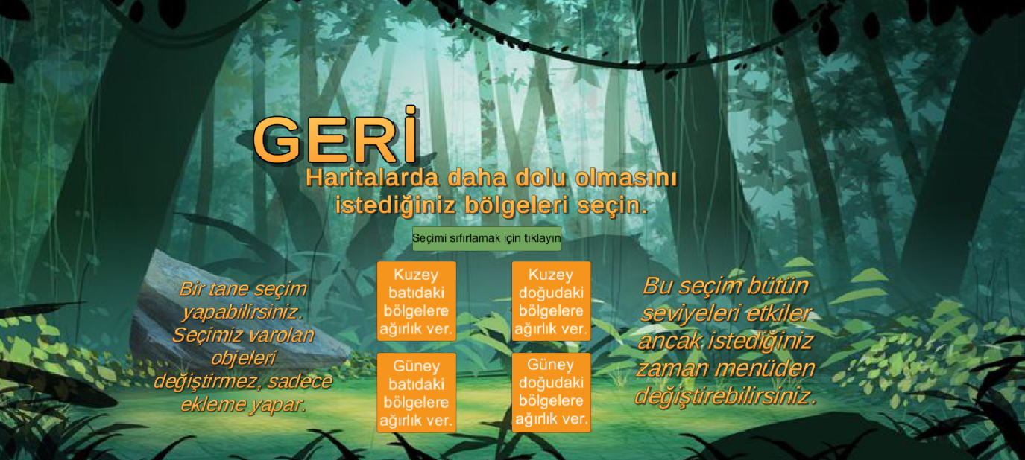

Slide 8
Hyperparameters: Sensitivity
The way and the amount the ball moves is important to the mechanics of the game, and is one of the things that can be modified by the therapist.
There is a default Normal Sensitivity which is quite sensitive to the movement performed on the Wii Balance Board.
Or it can be changed to Low Sensitivity which means the sensitivity will decrease and the amount of pressure and movement required to move the ball increases.
Even though the player controls the movement of the platform and not the ball, by increasing the gravity applied to the ball depending on the player preference that is passed from the menu, we can achieve the desired effect.

Slide 9
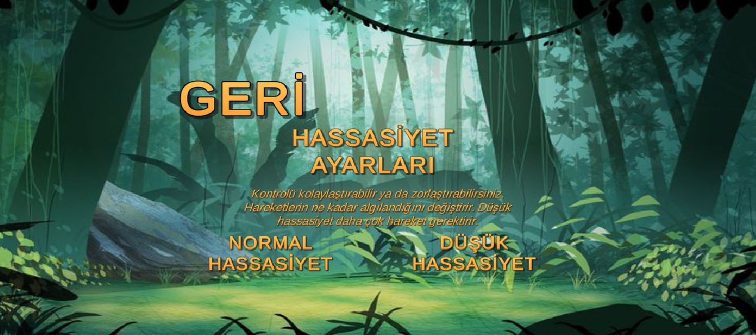

Slide 10
Additional Features to Improve Utility
You can pause and continue the game, restart, return to Main Menu anytime (which will lose your process and not generate a report).
The overall UI is very intuitive. During gameplay the only parameter player observes is the score, which is the grape count.
There is a short tutorial slideshow that is very informative in the child’s menu. We tried to be very open about every instruction to both the child and the therapist which can be observed in previous screenshots.

Slide 11
Additional Features to Improve Aesthetic
We created a custom model for our armadillo using Blender. Both the model and the surroundings were aided by public domain materials and textures so there is quite a lot of colour variation. This both helps differentiate the levels in the player’s eyes and also improves the concept.
The sounds and music were custom made for the game with previous steps’ research in mind. As stated in many reports, we tried to make it both enjoyable and relaxing and tried to stay true to the ambiance as well as the particular needs.
The sounds and the music was done by an actual game composer with a background in jazz, Kıvanç Nadir.

Slide 12
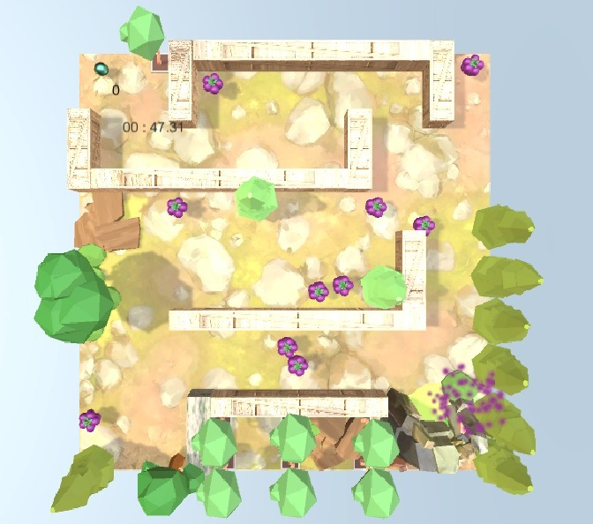
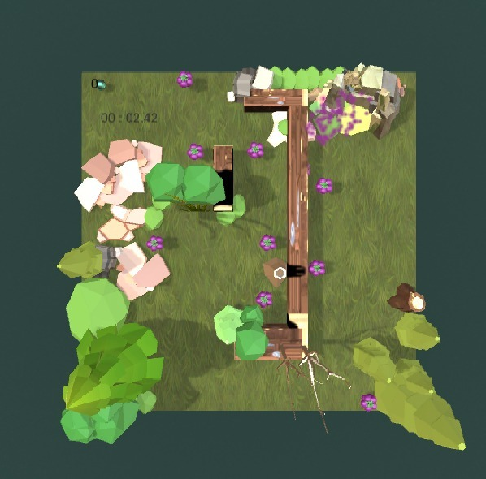
Some Levels in the Game
Both examples have extra grapes in their southeast zones

Slide 13
Accessibility & Performance
Using about 30 custom C# scripts (excluding python scripts for backend), utilizing layers and tags extensively to hypertune collision detection and tens of custom assets, this game can still be played on probably any computer.
And we chose Wii Balance Board rather than something custom or new because we wanted it to be purchasable from most big tech stores, if not, orderable all around Turkey.
Even though you need an internet connection to save reports to you person, the game can still be played.
Accessibility and performance were really important throughout the implementation of this project.

Slide 14
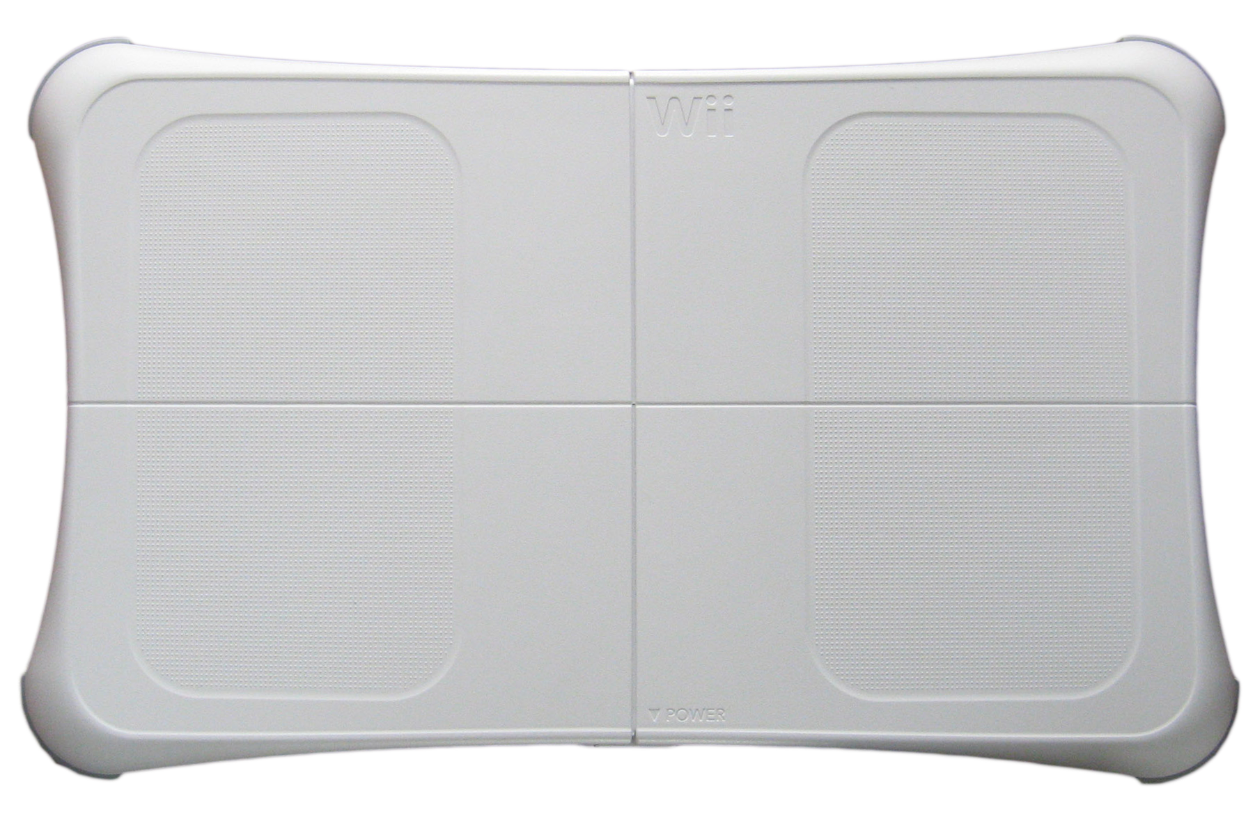
Wii Balance Board and Wii Balance Walker Program
In addition of being playable by keyboard,our
game is mainly designed to be played by Wii
Balance Board which is a product of Wii
To make the game playable and controllable
by the balance board use of a program called
“Wii Balance Walker” is required.
Wii Balance Walker is open-use Github project.

Slide 15
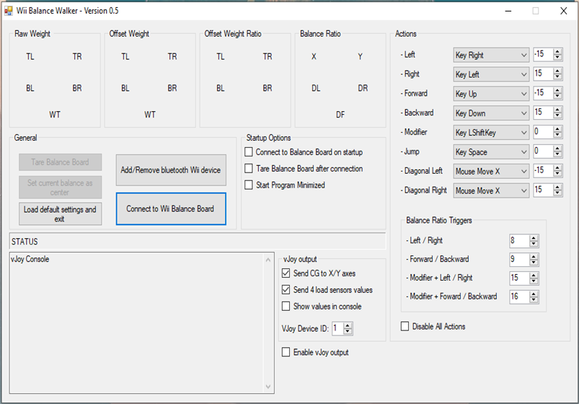
Wii Balance Walker
It is a program which requires bluetooth
hardware and Wii Balance Board to connect.
System is easy-to-use and once connected,
for following connections board is recognised.
“Tare Balance Board” default values, making
the board balanced before start of the game.
Can be played both standing and sitting.
Functions as a keyboard for specified controls.

Slide 16
Interaction Diagram Of Components
Backend
API
Unity Game
Report Interface
MongoDB Database

Slide 17
API
We use API service for components to communicate with each other. For this purpose, we chose to use the FastAPI framework.
In this way, we first send the data we collect from the game we designed in unity to our backend, and we can send the data we processed in our backend to our MongoDB database. When we need it later, we can retrieve this data again via API by sending a request to Unity or from the Report interface.

Slide 18
MongoDB Backend
After sending the data we collected from the game in the backend, we transform this data into classes with Pydantic and send it to the collections we created on mongoDB. Then, we can access the parts of this data whenever we want, via the backend.
We store the data with the ID that we created specifically for the username of the person, and then access it using this ID.

Slide 19
Report Interface
It is accessed through a React.js application that we developed because we believe that we can use it more effectively for the report interface compared to Unity. We also ensure that this interface communicates with the database by making a request to our API, so we can access the usernames list and the reports of that username.
In this way, we present the desired report of the desired user to the therapist on one screen of our React.js application.

Slide 20
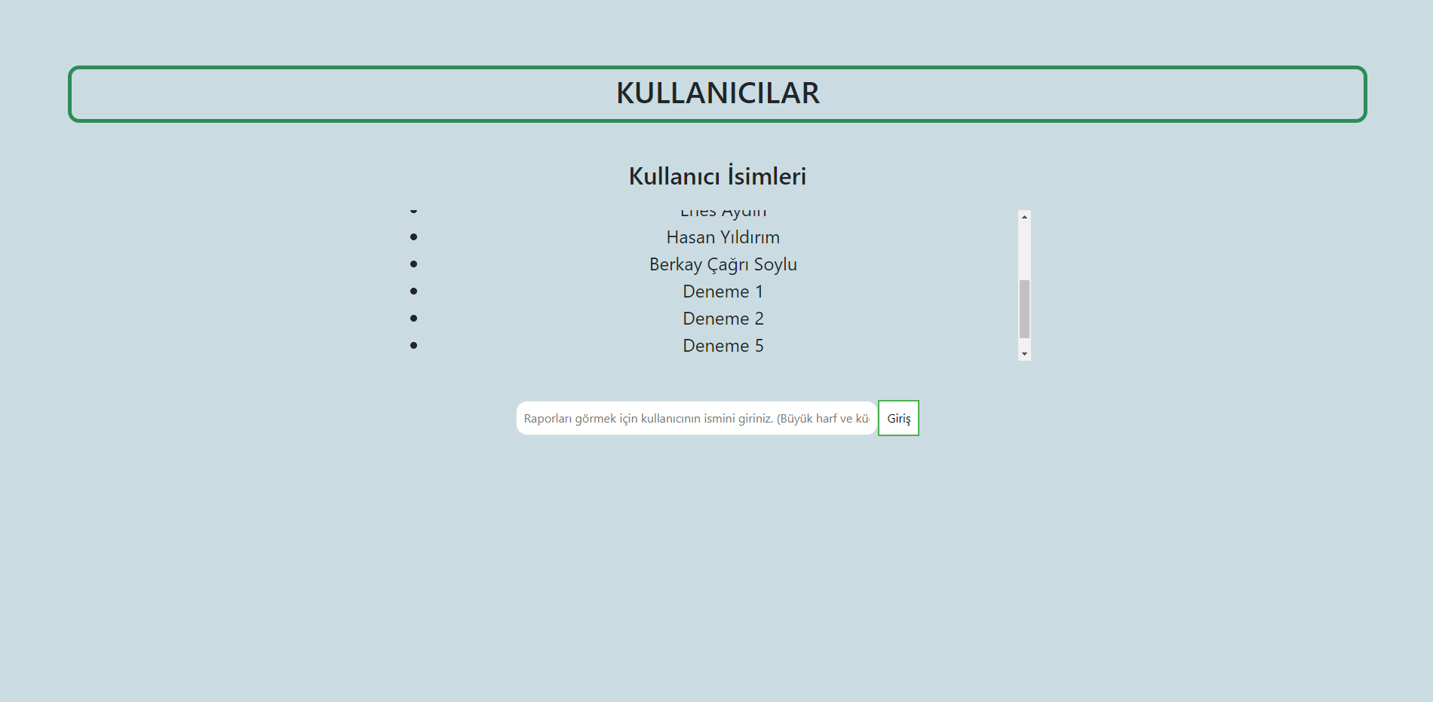
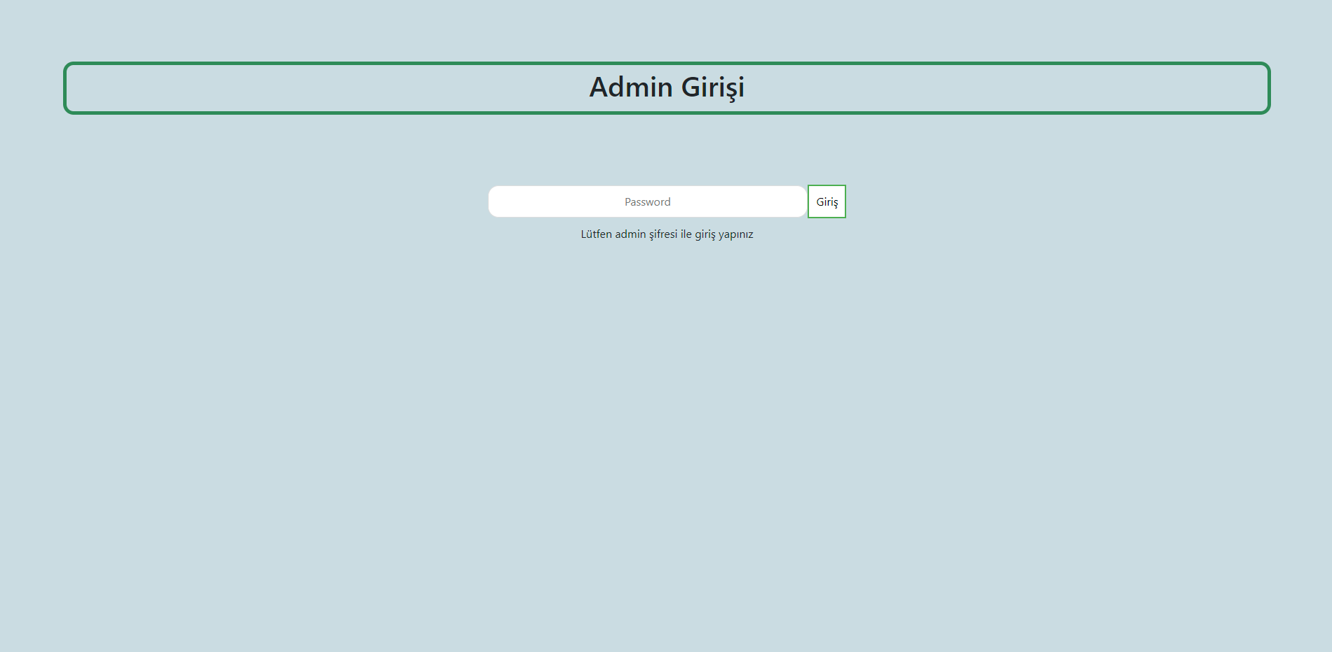
Admin Screens

Slide 21
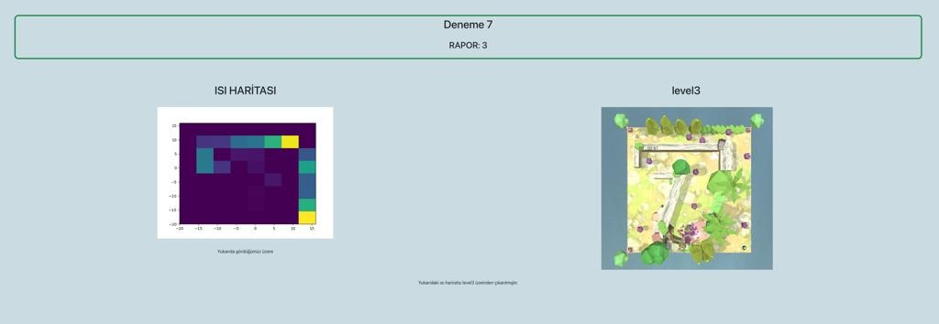
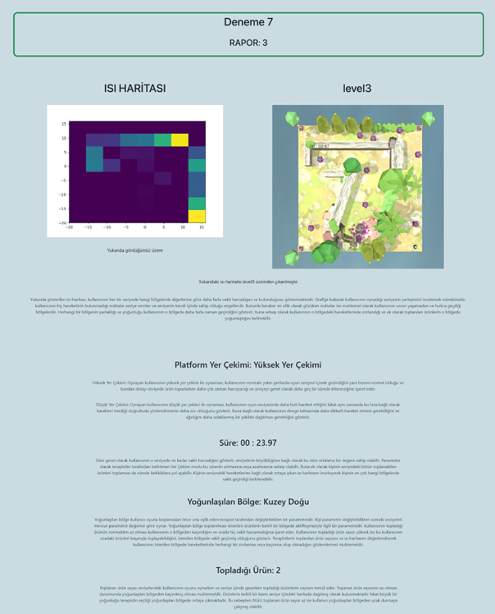
A report example

Slide 22
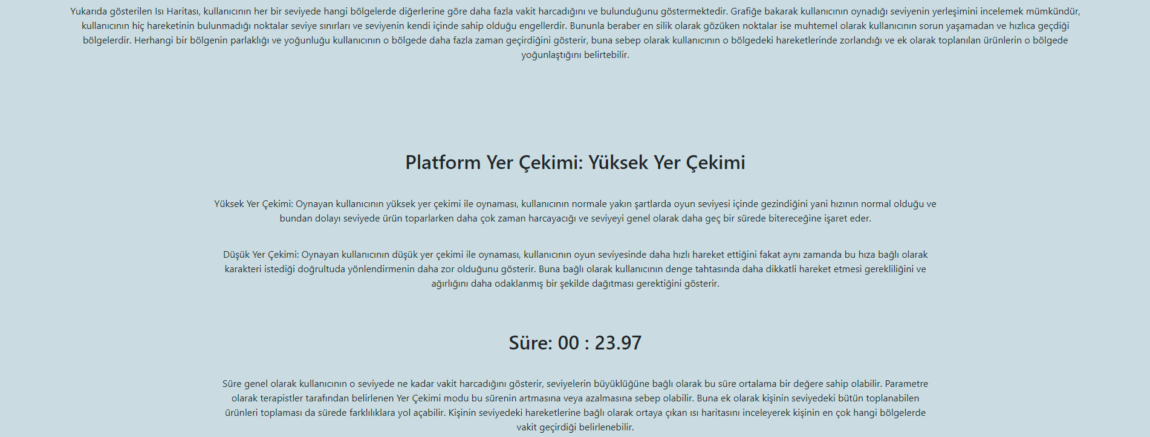
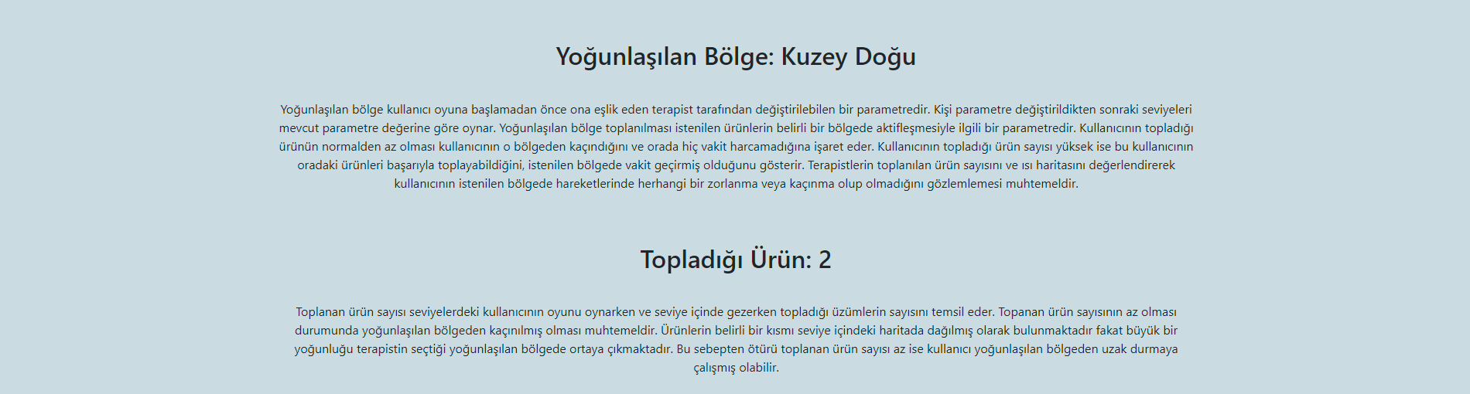

Slide 23
Backend
We do API communications, requests and responses, as well as all processing and editing works using Python scripts in our backend.
We are also using our Python scripts to make the data we receive meaningful, for example, processing the heatmap from the coordinates here and other data we collected.

Slide 24
Unity Game (Interaction with backend)
We communicate with Unity using our API in the same way, but unlike other components, we use special functions such as IEnumerator() and StartCoroutine() for this.
While doing this, we send the data in classes, so we had to create a class for both the patient, reports and some other individual data. In this way, we have accessed the data we stored in these classes to our backend in packages.

Slide 25
Evaluation of the System -1
The system generates a report based on performances for each played level which is stored and later accessed, providing information about the duration and the general movement of the player during gameplay.
Parameters are easy to change through the interface of the game.
Game is simple to understand and not hard to play either by standing on the board or sitting and adjusting the weight on the board accordingly.
Game is unisex and focuses on the balance and shifting the person’s weight according to the direction the player needs to move.
Report page is filled with explanations which can be improved and updated according to feedback from the therapist and result in more precise insight.

Slide 26
Evaluation of the System -2
Interface and user-interaction is easy to use and understandable.
The sense of achievement and its’ measure is given by using “scores”.
Parameters being changed reflects directly to the gameplay, making the player adjust their play-style accordingly.
Instructional support is given by a tutorial image given before the first level.
Feedback is given to the player at the end of each level, displaying the time, scores they completed the level with.
Challenge of the game is that player needs to use core balance and stability to adjust their weight and traverse through the map. Challenge level of the game can be adjusted by the use of parameters as well.

Slide 27
Evaluation of the System -3
Through each level, player can choose their own path to the goal, as well as choosing to collect more collectables with the trade-off of time spent.
The only animal in the world who can do “ball up” is the Three Banded Armadillo. Game provides the story of such an armadillo trying to free herself from her ball form. She is stuck. She’s not strong enough just yet. By collecting grapes and becoming stronger, eventually she’s able to get out of her ball form at the end of Level 10. We wanted to show how her work pays off to be a motivate the player.
Game is not cooperative or contains social interaction.
Clear goal is set as the levels are designed in a way which provides the player with the use of collectables during the path to the end points which are caves.

Slide 28
Evaluation of the System -4
Motivation is provided by the use of sound effects and collectables.
Playing the game and being able to steer the Three Banded Armadillo successfully to the caves by player adjusting their weight and balance while collecting grapes provides the sense of accomplishment and triumph.
Every move the player performs is directly related to the movements of the Three Banded Armadillo which makes the engagement on a high level during gameplay.
Playing levels and replaying, results in the increase of self-regulation and better performance overall.
Effort for figuring out how to move the Three Banded Armadillo faster and more precisely is both physical and mental, as it requires both balance and coordination.

